Slide 1
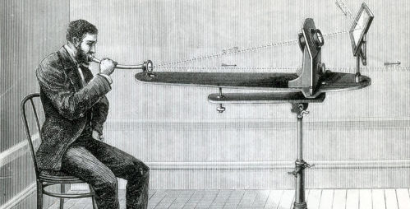
An Introduction to Photoacoustics

Slide 2
Outline
What is the photoacoustic effect?
  What is sound?
  How can sound be generated from light?
The spectroscopy of atmospheric aerosol
Photoacoustic Spectroscopy
  Basic principles
  Confusions
  Modeling an asymmetric cell
Future Work

Slide 3
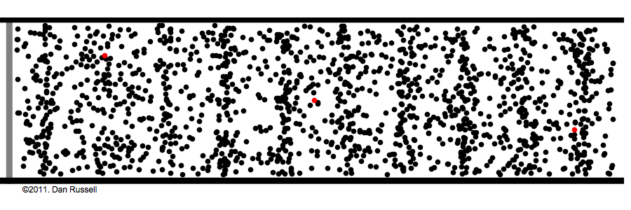
Sound
Sound is a longitudinal pressure wave
  Particles in wave propagate/travel in the same direction as the wave
Average pressure stays the same, but pressure at any one spot in the wave changes all the time.
  Due to collisions between particles and momentum transfer.
  With more collisions, a wave can move faster.

Slide 4
Sound from a light source
One of Alexander Graham Bell’s (many) discoveries.
  Interested in long-distance sound transmission.
  Used a focused sunlight source.
  Spoke through a deforming mirror that caused light to reflect/scatter more depending on what’s being said.
  Reflected light passes to an object that can turn the sunlight into acoustic energy/sound (transducer).
    Used carbon black (produced from incomplete combustion of vegetation/tar/oils) at first.
    Later versions converted sunlight into electricity first before converting again into sound.

Slide 5
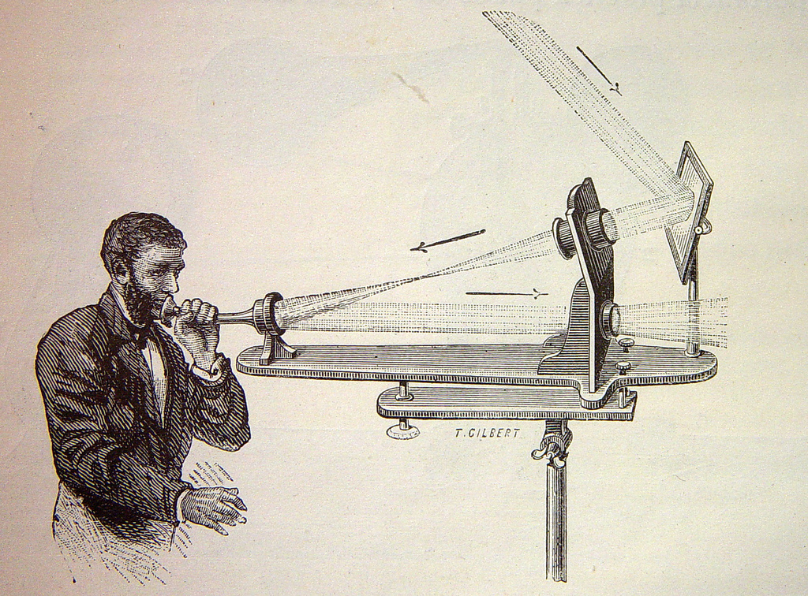
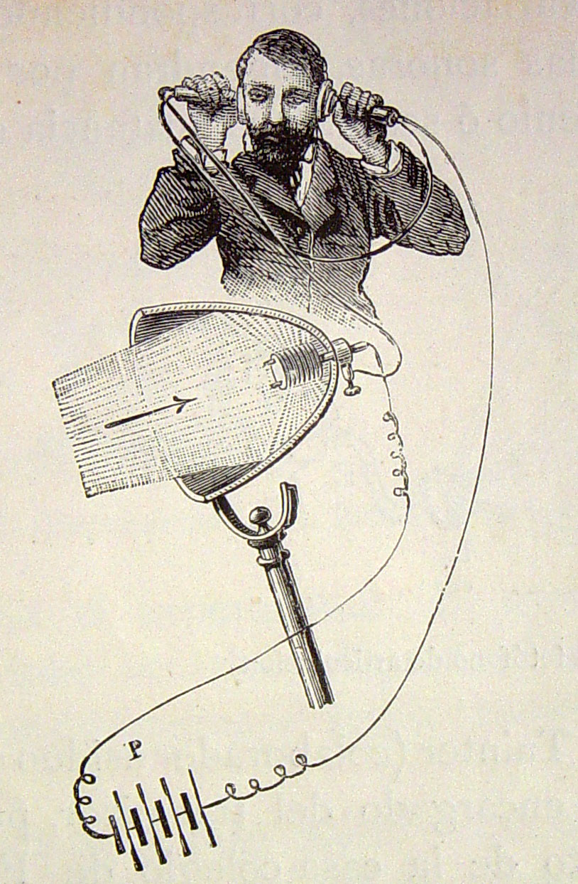
How a photophone works
h.
h.
Sunlight comes in
Goes through focusing lens
Hits deforming mirror
Voice-modified light sent back out
Sent through another lens
Light focused with parabolic mirror
Light energy converts to electrical signal*
Electricity converted to acoustic energy – sound!
a.
b.
g.
c.
f.
d.
e.
Great inspiration for the fiberoptic cable revolution!

Slide 6
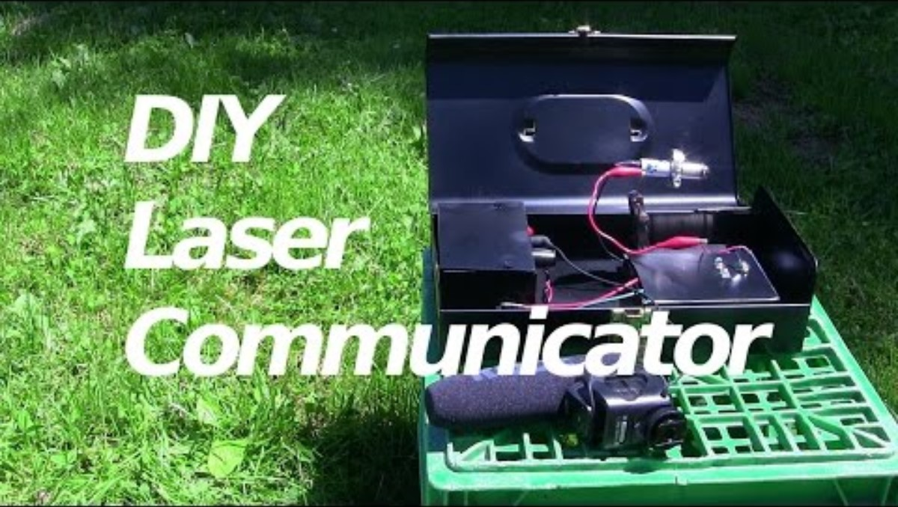
Photophone Demo
Credit: RimstarOrg

Slide 7
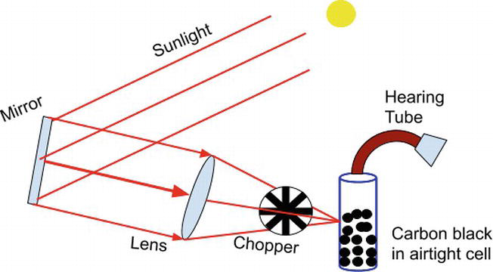
The Photoacoustic Effect
Bell found in his studies that you can shine light on a solid object too to produce sound—if that light source is power-modulated (chopped)
  Later discovered that this also applies to other types of matter too.
  This fact was not used for many years.
    Now forms the basis of photoacoustic spectroscopy.

Slide 8
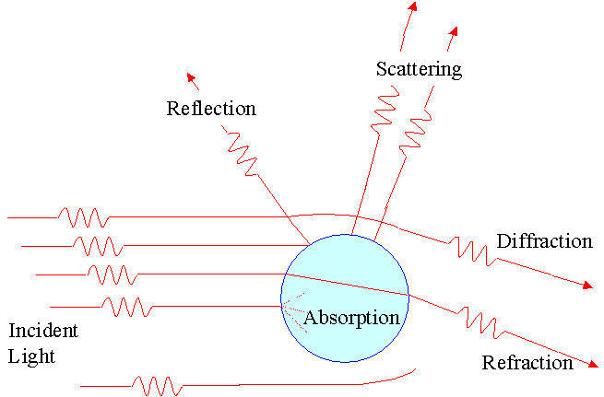
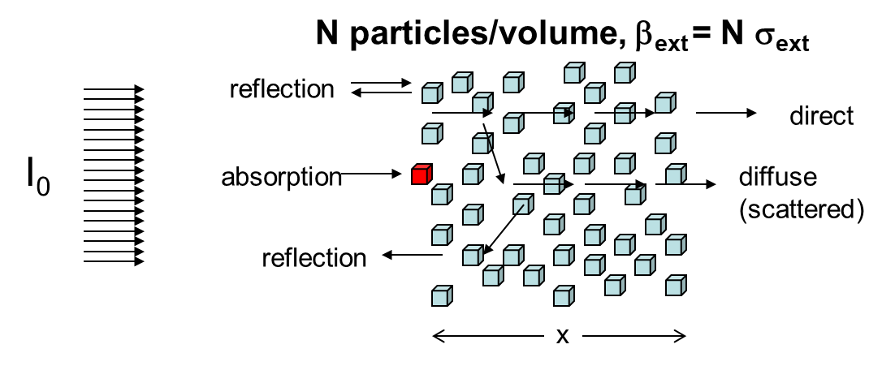
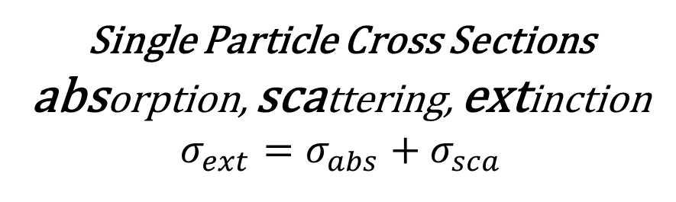
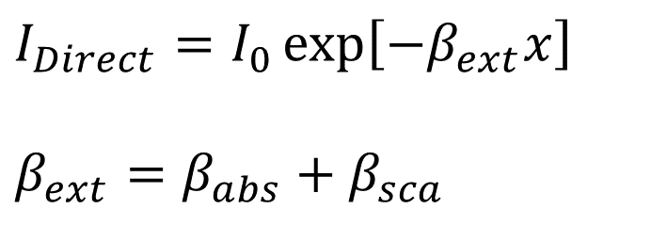
Spectroscopy of Aerosol
Single Particle
Multiple Particles
Direct Beam of Light:
Beer’s Law
Single Particle Cross Sections
absorption, scattering, extinction
$$σ_{ext}=σ_{abs}+σ_{sca}$$
$$I_{Direct}=I_{0}\exp\left[−β_{ext}x\right]$$
$$β_{ext}=β_{abs}+β_{sca}$$

Slide 9
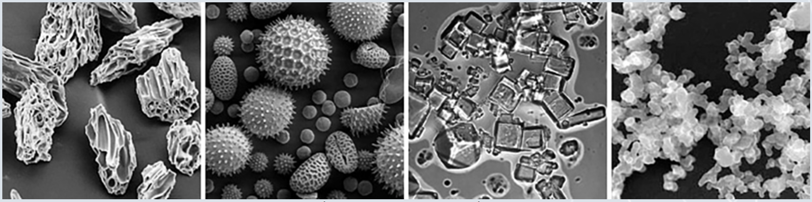
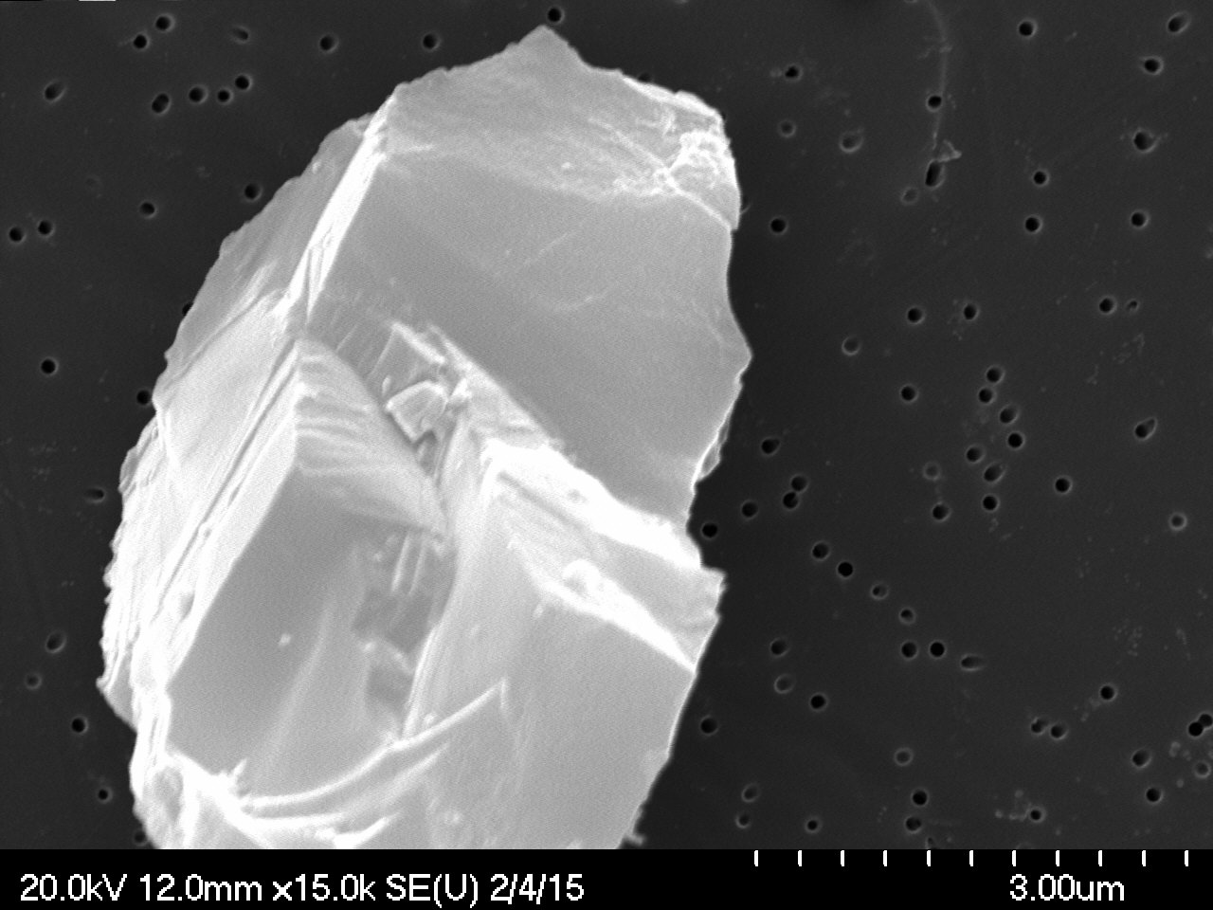
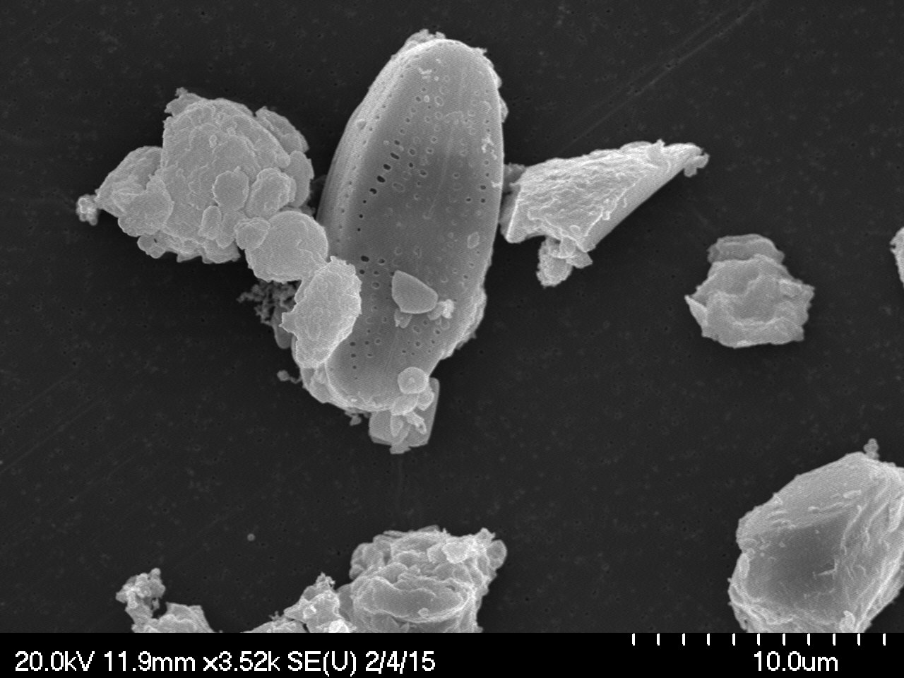
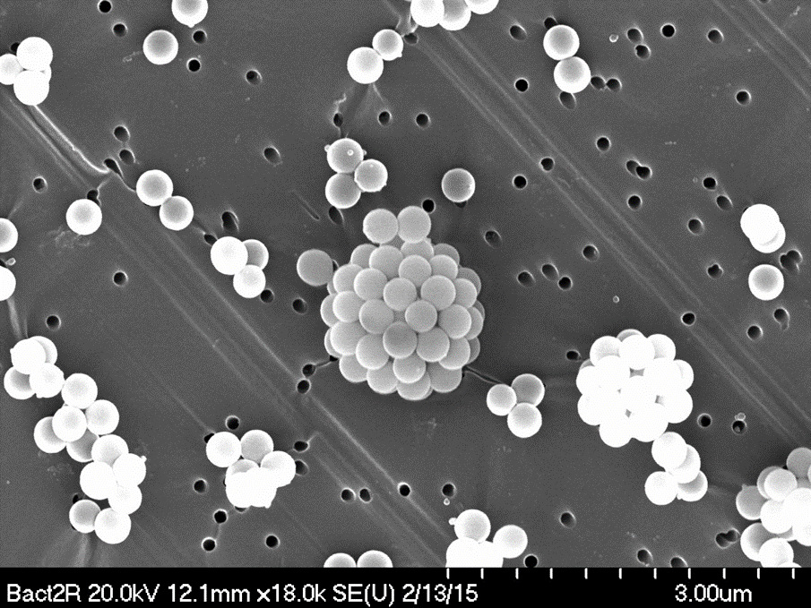
Aerosol Examples
Volcanic Ash
Pollens
Sea Salt
Soot
Incense
Glass beads
Coal and Silica

Slide 10
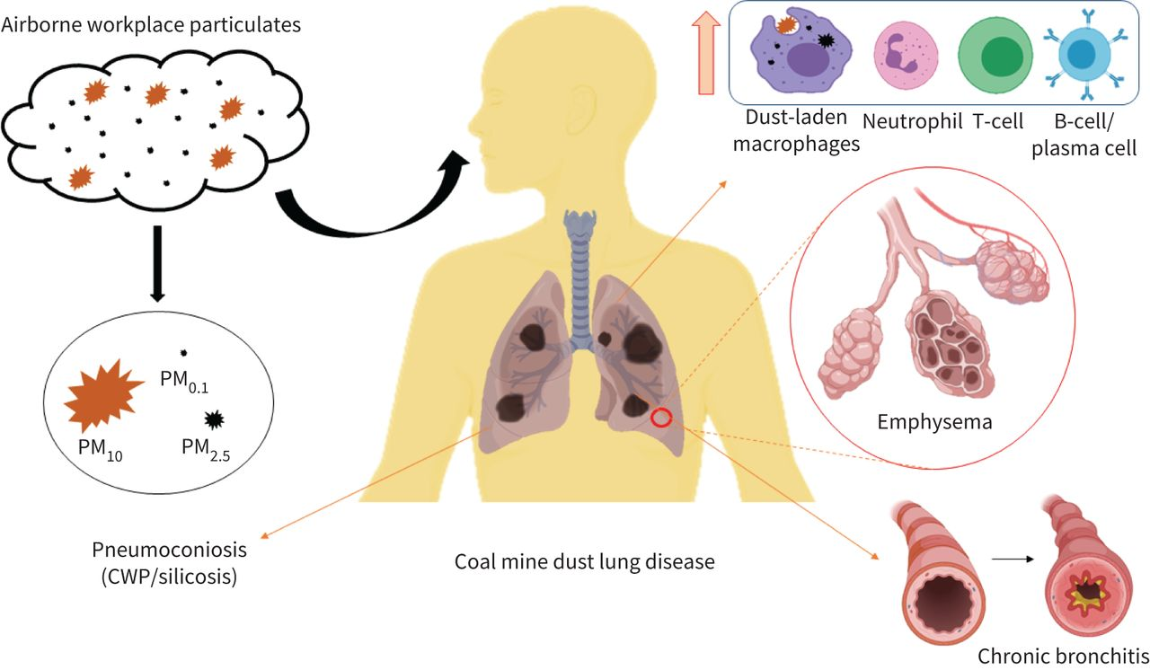
Health of Workers in the Mining and Construction Industries:
Pathogenesis of dust particulate matter-associated occupational lung diseases.
Our Work Aims at Providing Real Time Measurements of Speciated Dust Mass Concentration
Kanth Swaroop Vanka et al. European Respiratory Review, 2022;31:210250
©2022 by European Respiratory Society
Notes:
Pathogenesis of dust particulate matter (PM)-associated occupational lung diseases. Schematic shows the entry of particulate matter (PM₁₀ and below) through environmental/occupational exposure into lungs and development of subsequent respiratory complications, which include increased cellular influx (macrophages, neutrophils, T-lymphocytes and B-cells), alveolar destruction (emphysema) and structural changes (collagen and mucus deposition) leading to chronic bronchitis. PM_{x}: particles with a 50% cut-off aerodynamic diameter of x µm; CWP: coal worker's pneumoconiosis.
Abstract
Workers in the mining and construction industries are at increased risk of respiratory and other diseases as
a result of being exposed to harmful levels of airborne particulate matter (PM) for extended periods of
time. While clear links have been established between PM exposure and the development of occupational
lung disease, the mechanisms are still poorly understood. A greater understanding of how exposures to
different levels and types of PM encountered in mining and construction workplaces affect
pathophysiological processes in the airways and lungs and result in different forms of occupational lung
disease is urgently required. Such information is needed to inform safe exposure limits and monitoring
guidelines for different types of PM and development of biomarkers for earlier disease diagnosis.
Suspended particles with a 50% cut-off aerodynamic diameter of 10 μm and 2.5 μm are considered
biologically active owing to their ability to bypass the upper respiratory tract’s defences and penetrate deep
into the lung parenchyma, where they induce potentially irreversible damage, impair lung function and
reduce the quality of life. Here we review the current understanding of occupational respiratory diseases,
including coal worker pneumoconiosis and silicosis, and how PM exposure may affect pathophysiological
responses in the airways and lungs. We also highlight the use of experimental models for better
understanding these mechanisms of pathogenesis. We outline the urgency for revised dust control
strategies, and the need for evidence-based identification of safe level exposures using clinical and
experimental studies to better protect workers’ health.

Slide 11
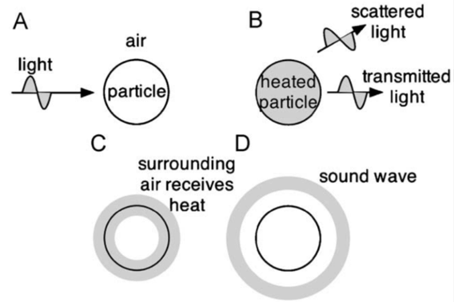
Photoacoustic Instruments For Light Absorption Measurements
(or other
wavelength)
Basic principles:
Laser light is power modulated by the chopper.
Light absorbing aerosols convert light to heat - a sound wave is produced.
Microphone signal is a measure of the light absorption.
Light scattering aerosols don't generate heat.

Slide 12
Single Laser Photoacoustic Instrument: Equation to Obtain the Light Absorption Coefficient

Slide 13
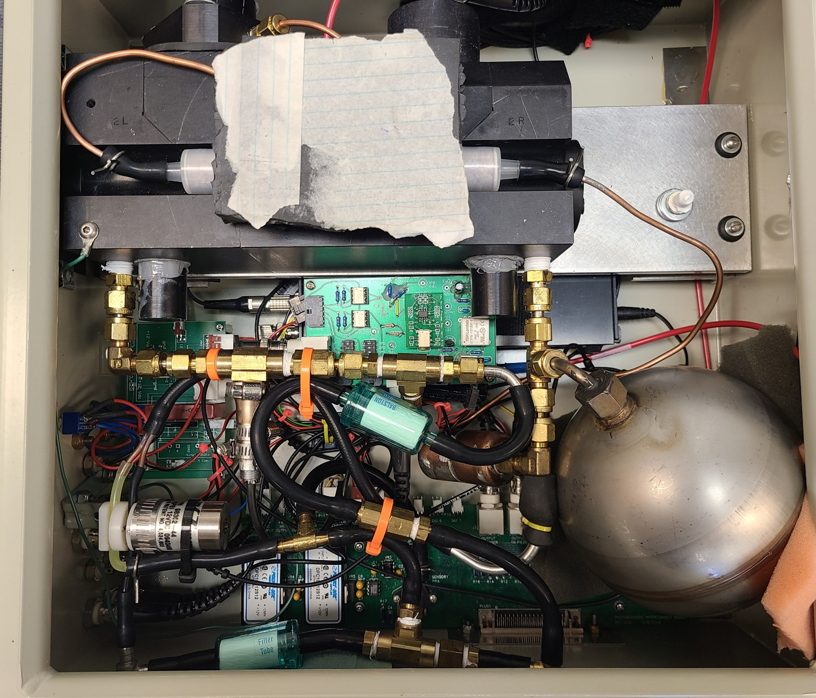
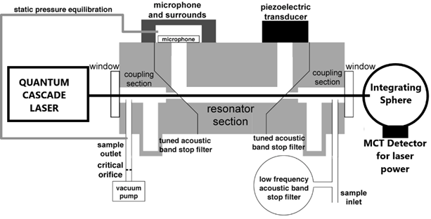
The Instrument
Mic
Piezo
Laser exit
Photoacoustic Resonator
Tuning tube
Helmholtz
Resonator
Features a tunable quantum cascade laser (QCL) which goes through the cell to an integrating sphere with an LN2-cooled MCT detector for laser power measurements.
Two Helmholtz resonators are in place for band-pass filtering of noise on inlet side.

Slide 14
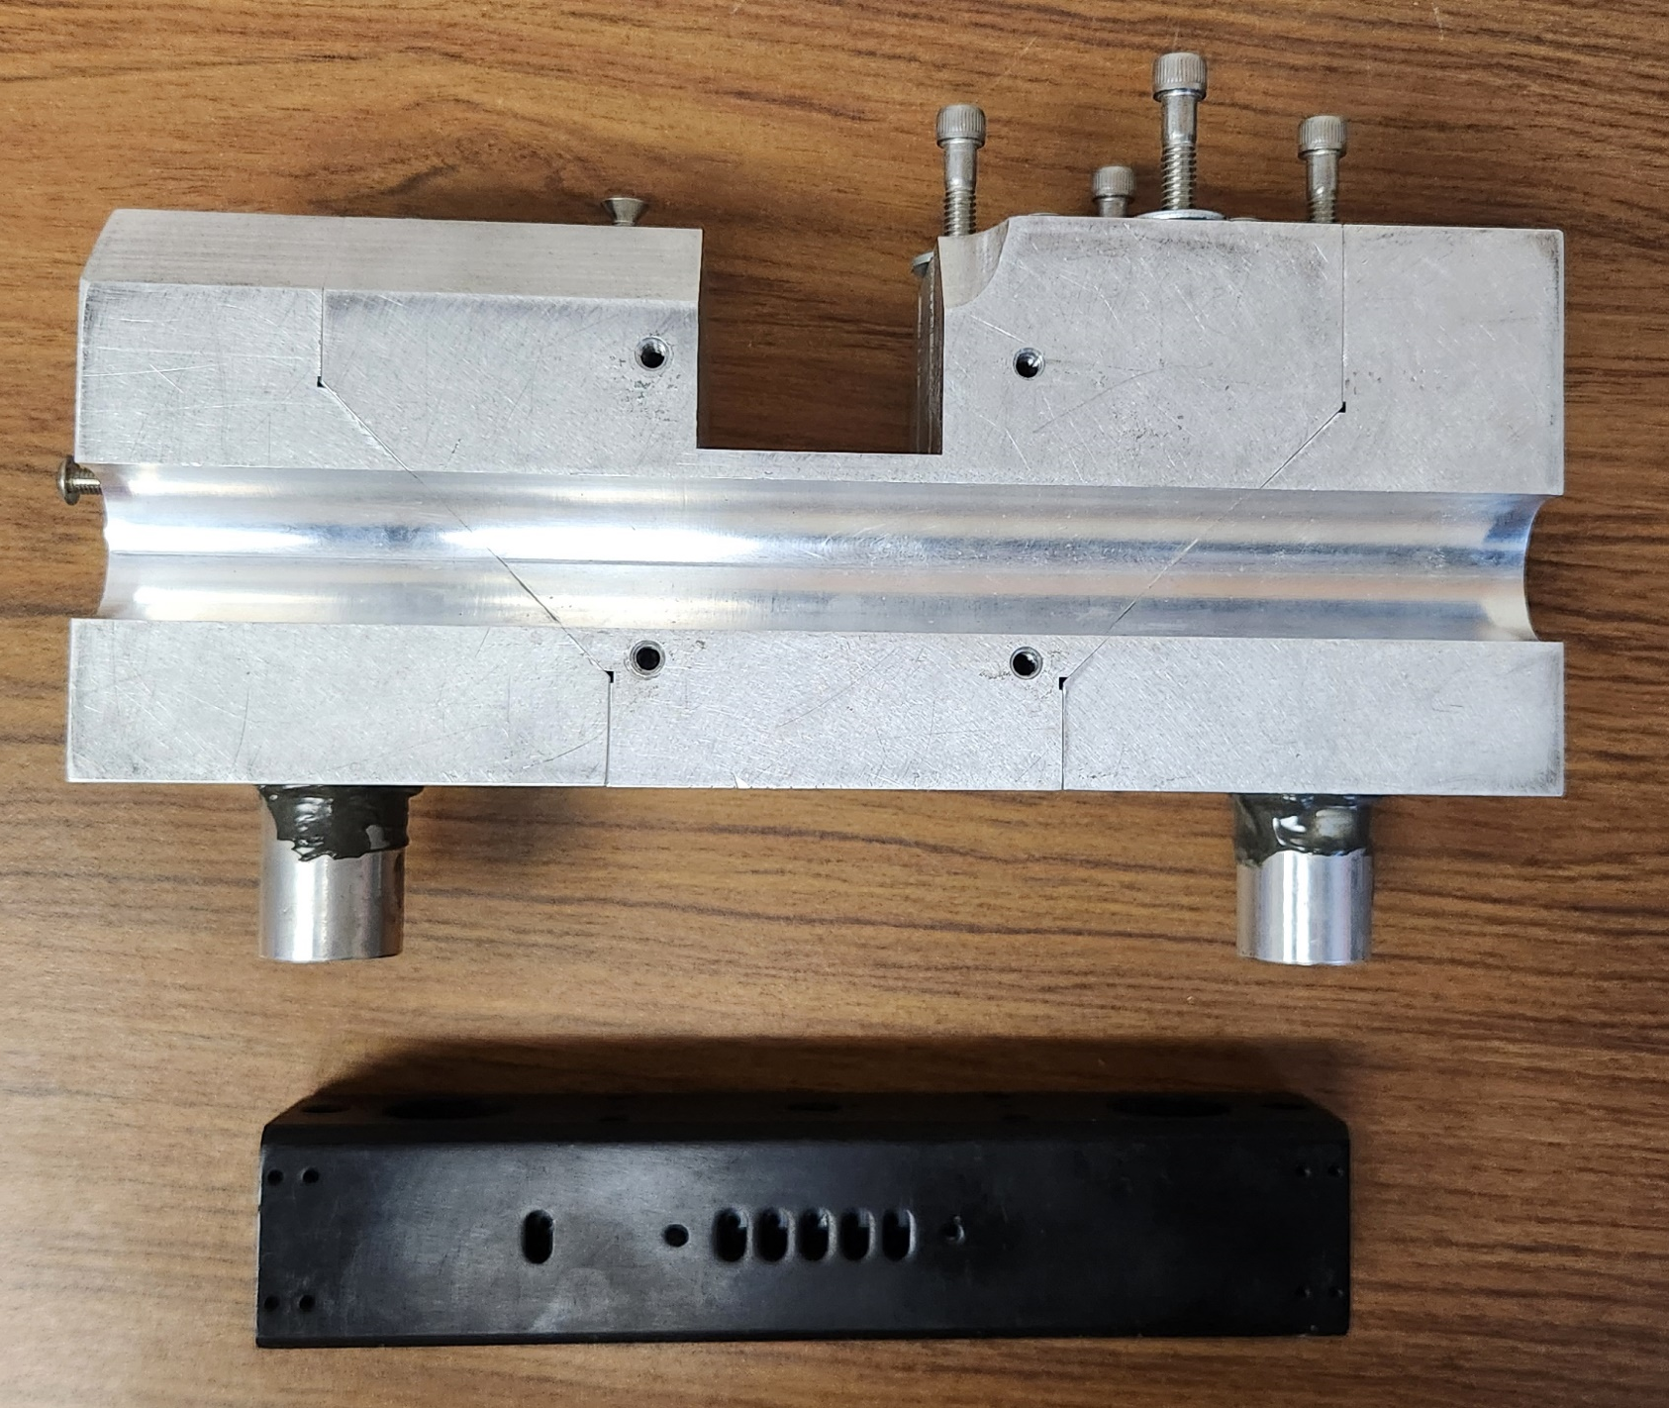
The Need for a Smaller Instrument
Current instrument is bulky and not easily portable.
Increasing resonant frequency of cell decreases total size
  But also introduces phase issues from larger aerosol not being able to completely thermally relax.
    Prevents full pressure wave formation from coarse-mode aerosol.
    Might be used to our advantage—thermal size cut
Past version of cell (considered in this presentation) compared to smaller, newer iteration

Slide 15
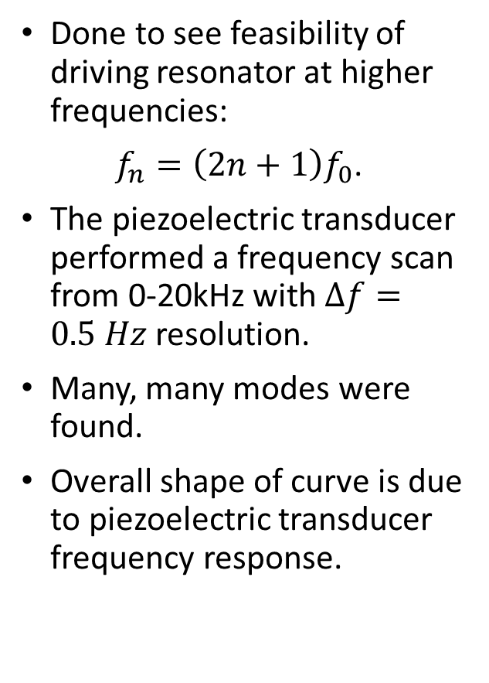
Initial Frequency Scan
Done to see feasibility of driving resonator at higher frequencies:
$f_{n}=\left(2n+1\right)f_{0}$.
The piezoelectric transducer performed a frequency scan from 0-20kHz with $Δf=0.5 Hz$ resolution.
Many, many modes were found.
Overall shape of curve is due to piezoelectric transducer frequency response.

Slide 16
Spotting spurious modes
Fundamental should drive 3x harder than first harmonic.
  Measurements showed only driving 2.2 times higher.
Three unexpected modes are also found to very effectively absorb—even more so than the fundamental!
  What?

Slide 17
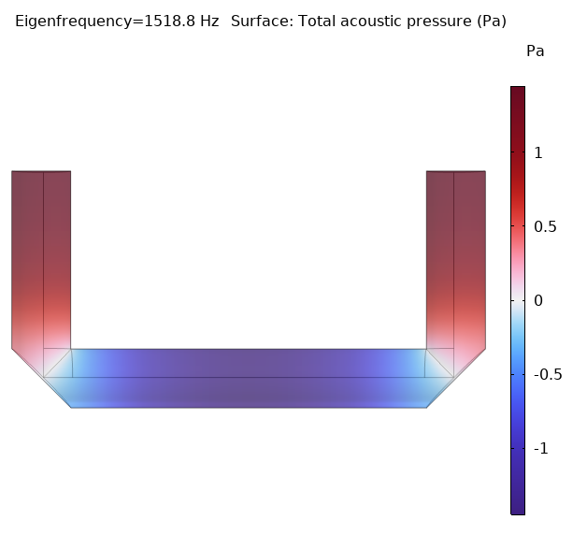
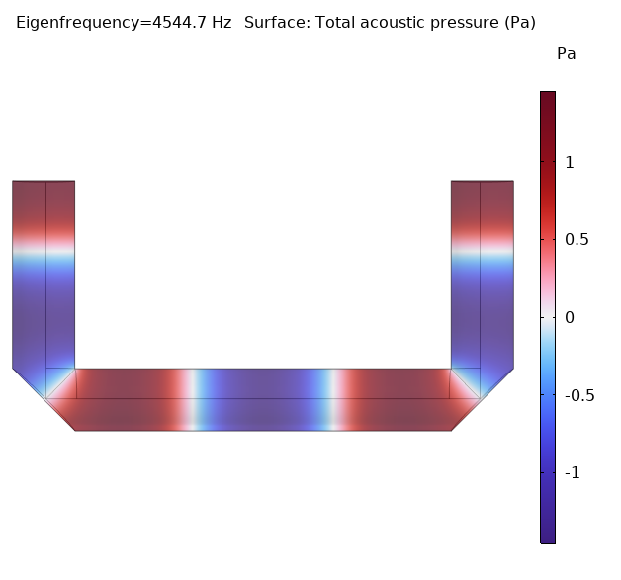
Increased frequency = less drive
Higher modes have less net pressure excursion; compressed and rarefacted sections of the pressure wave cancel out.
Laser path

Slide 18
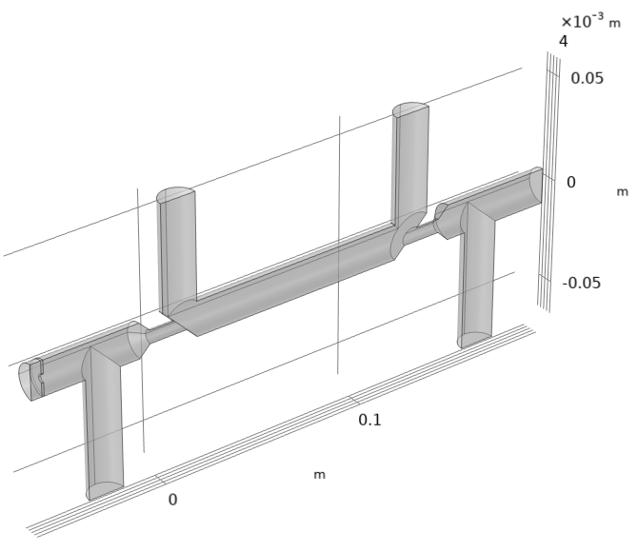
Aperture

Slide 19
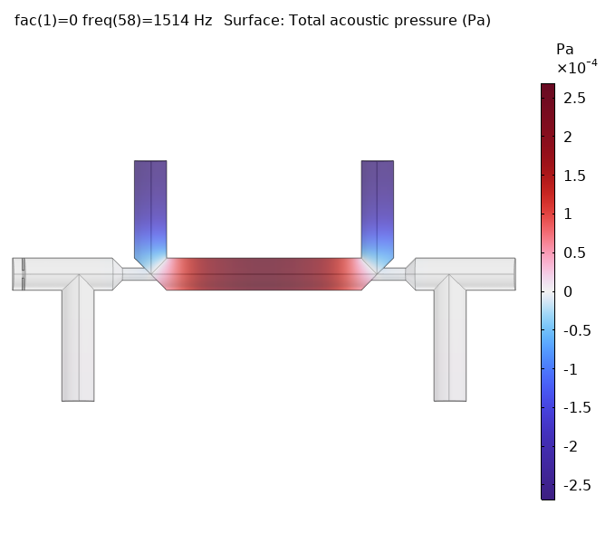
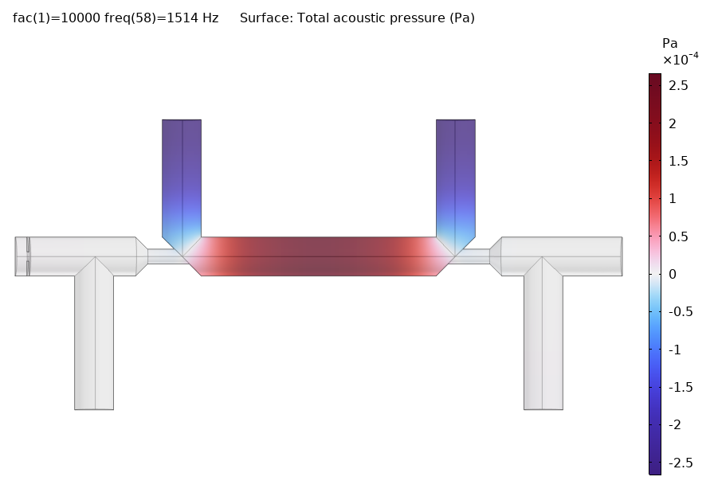
The Fundamental

Slide 20
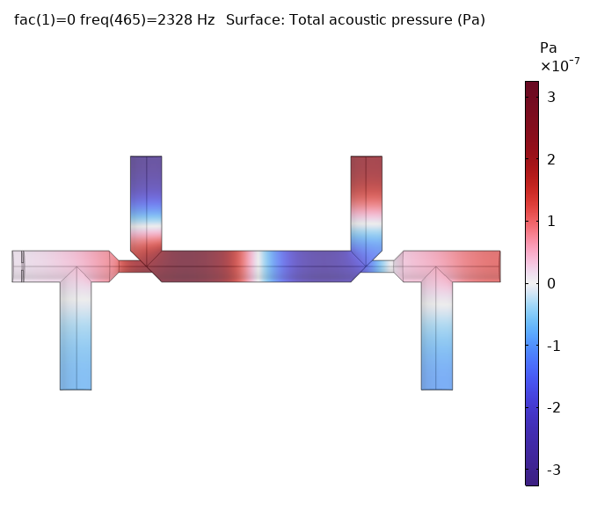
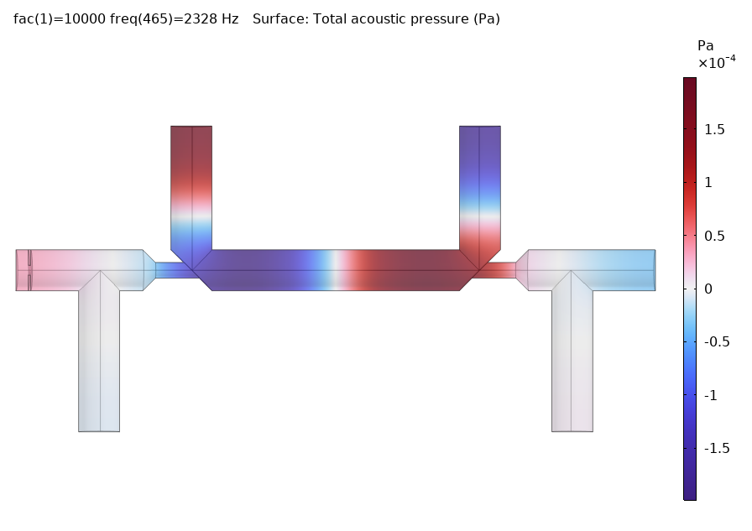
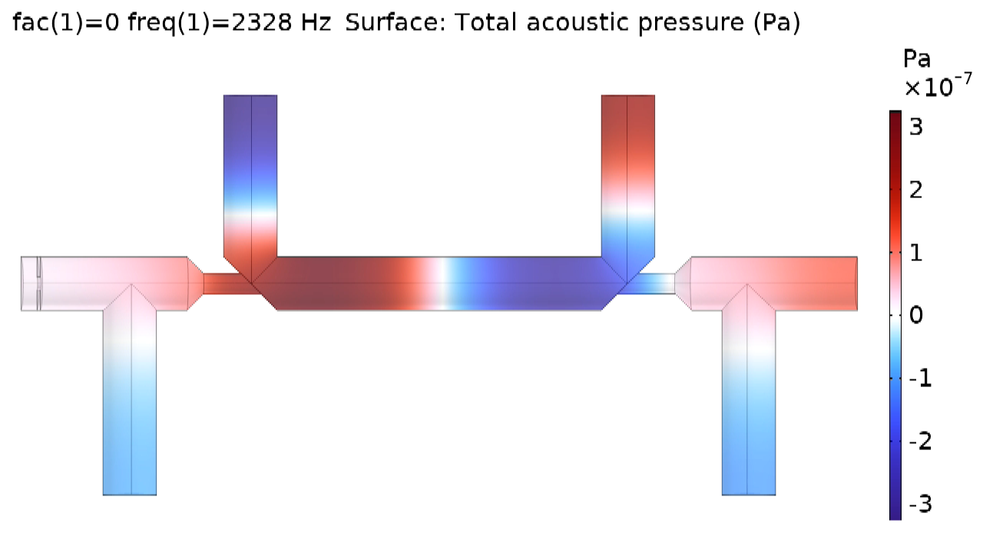
Stray Mode Compared

Slide 21
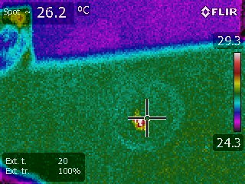
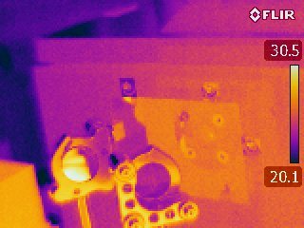
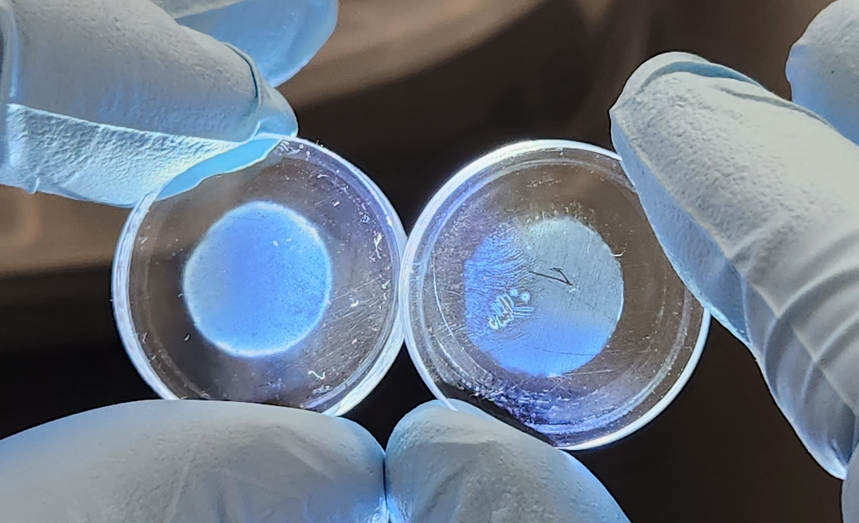
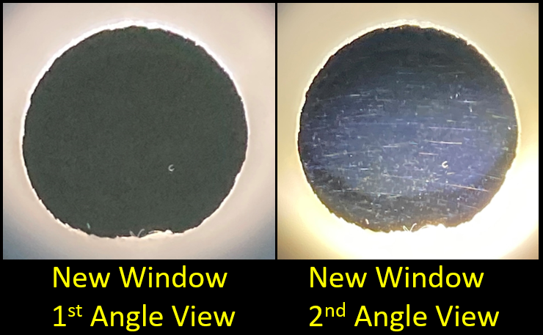
Pre-and-Post Alignment and Window Change
The KBr windows were removed from the cell to check for cleanliness.
  Both windows cloudy
  Exit window was filthy!
An FLIR E40 infrared camera was used to see if QCL was clipping aperture next to laser entry window.
  It was.
Power measurements were calculated with 1 window in place and without any windows for transmission measurements.

Slide 22
Laser Power Spectra and Window Transmissions
Estimated Power Loss from aperture at 12.53μm: 0.732mW

Slide 23
Comparing Experiment to Model

Slide 24

Future (and Current) Work
Introduce laser attenuation by absorption to the model.
Model inlet effect on frequency distribution.
Restart testing of smaller cell and optimize it.
Continue to explore driving the cell at a higher frequency and the thermal size cut.
Develop a portable and reliable instrument to help prevent exposure to dangerous aerosol and excessive air pollution.

Slide 25
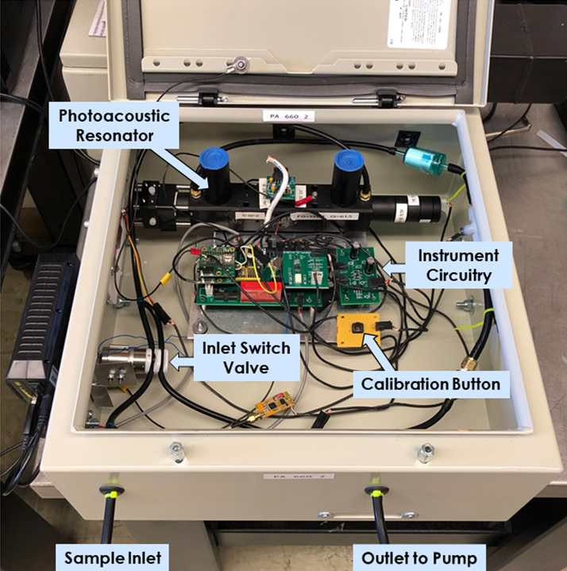
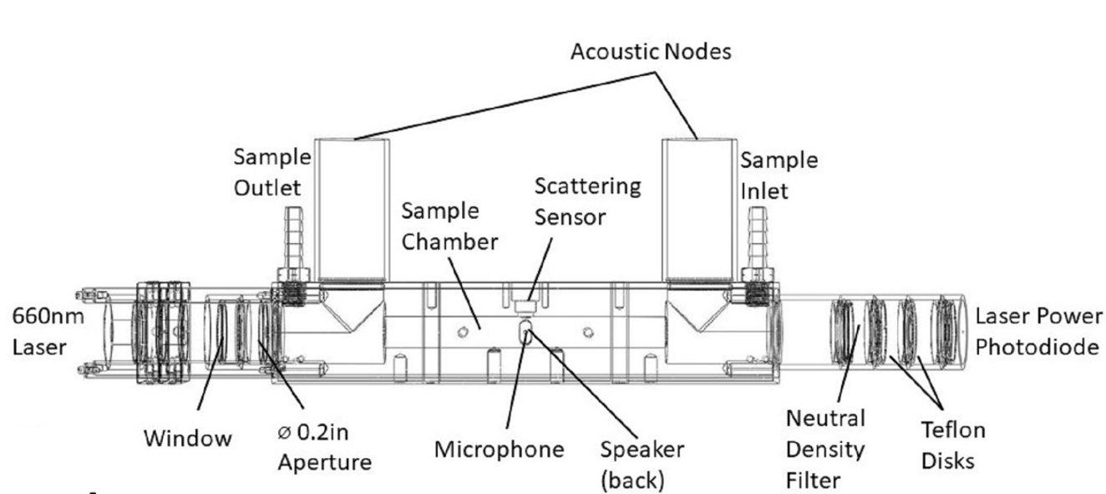
Future Work Continued
We are developing a more compact instrument with a microcontroller data acquisition system
Photoacoustic Resonator

